Slide 1

TruthGuard
AI-Powered Fake News Detection & Verification Platform

Slide 2
Project Statement
Misinformation and fake news threaten society, democracy, and public trust
Exponential growth of online content makes manual verification impractical
Need for automated, intelligent system for news authenticity analysis
Objectives
Develop AI-powered web app for real-time fake news detection
Integrate NLP and Google Gemini AI
Provide credibility scoring, fact-checking, and source verification
Create intuitive UI with user management and history
Implement chatbot for guidance and support
Scope
User authentication and profiles
Text/URL-based content analysis
AI credibility assessment
Dashboards for users and admins
Integrated chatbot functionality

Slide 3

Outcome
Functional Flask-based web platform for fake news detection
Integration with Google Gemini AI for advanced analysis
Secure user management with role-based access
Comprehensive analytics dashboard
Scalable, modular architecture
Documentation for educational value

Slide 4

Modules to be Implemented
User Management: Registration, login, profiles, role-based access
Content Analysis: Text/URL input, AI processing, NLP (sentiment, sensationalism), credibility scoring (0-10 scale)
Database: Store user data, analysis history, chat logs
Dashboard & Analytics: User overview, admin stats, Chart.js visualizations, report exports
Chatbot: TruthBot with Gemini AI, fallback rules, session context
Admin: User administration, system monitoring, content moderation

Slide 5
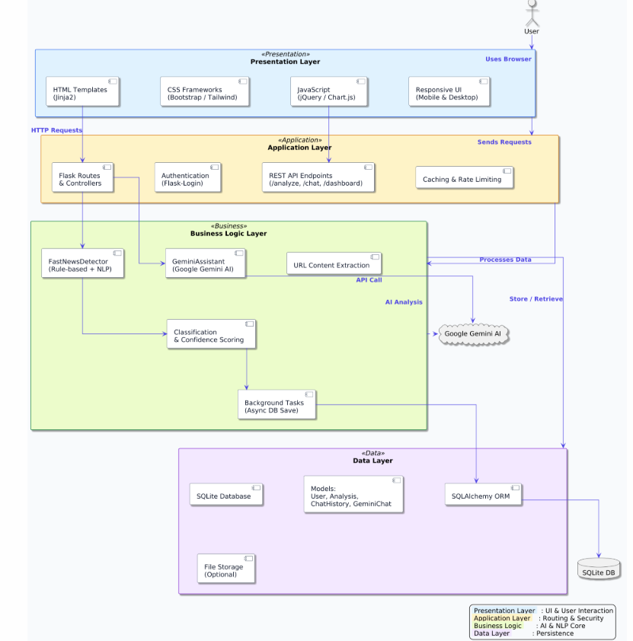
Architecture Diagram

Slide 6
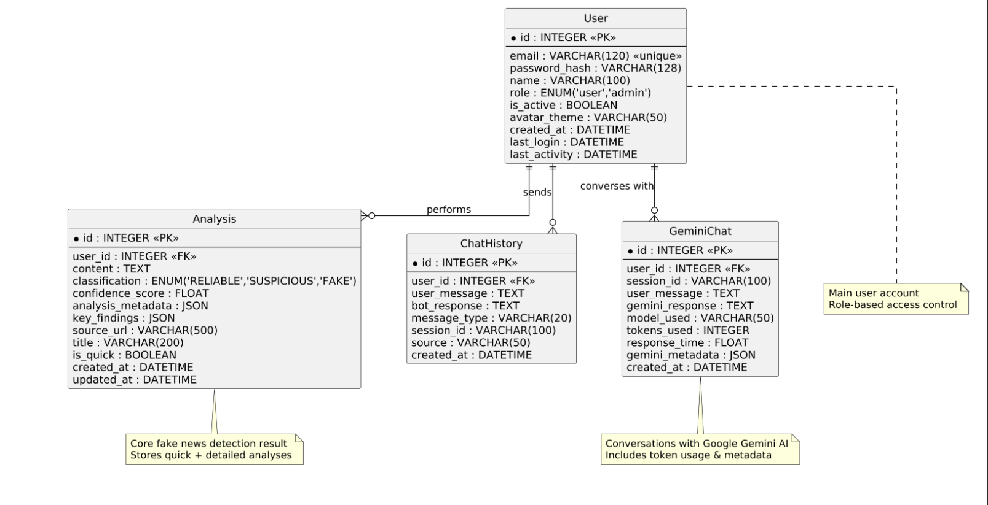
Database Schema

Slide 7

Conclusion
Project Achievements
Integrated Google Gemini AI with Flask for misinformation detection
User-centric design with intuitive UI and management features
Scalable architecture for future growth
Practical solution for real-world fake news challenges
Future Enhancements
Multi-language support
Custom ML models for domain-specific detection
Social media integration
RESTful API for third-party use
Mobile app development

Slide 8
Conclusion
Learning Outcomes
AI integration experience (Gemini AI)
Full-stack web development
Database design and optimization
Web security best practices
Project management
Impact
Contributes to combating misinformation
Promotes digital literacy and fact-checking
Foundation for research in automated verification

Slide 9
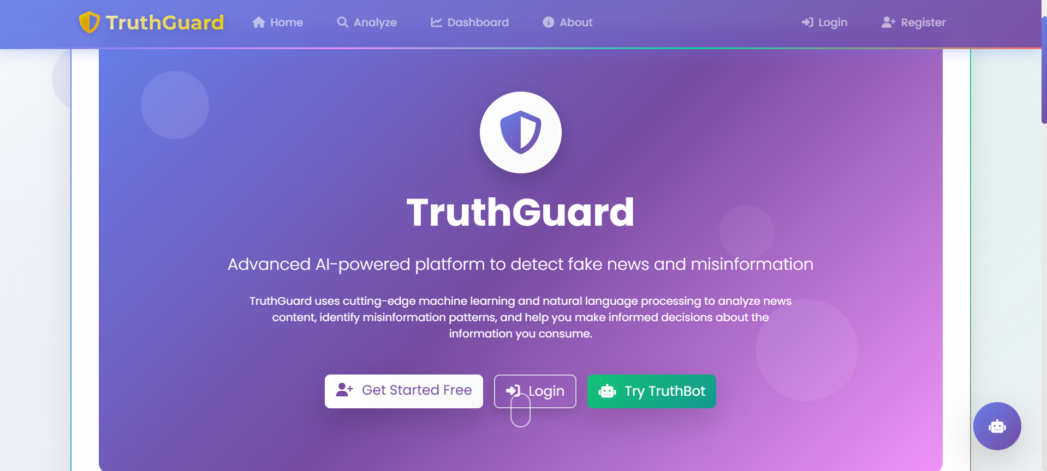
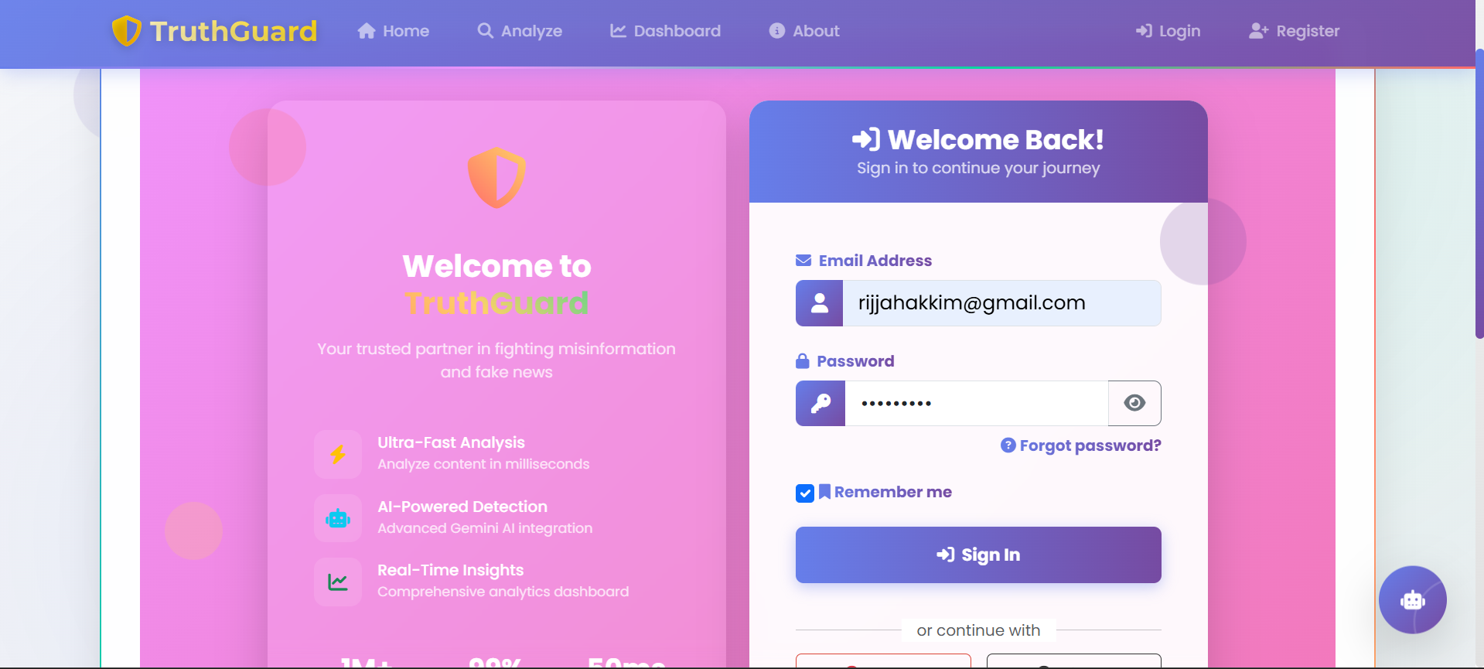
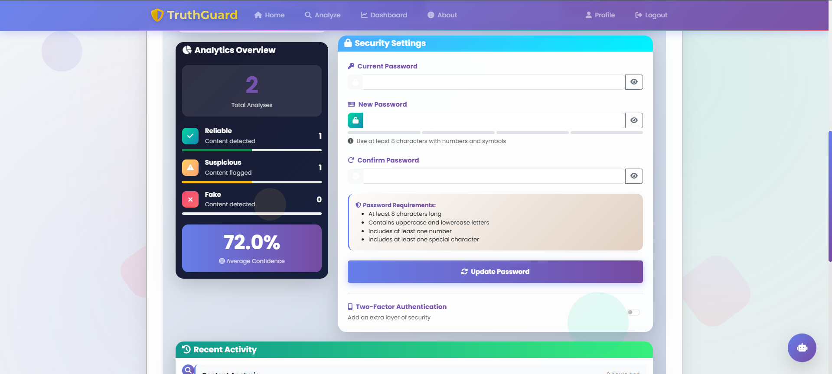
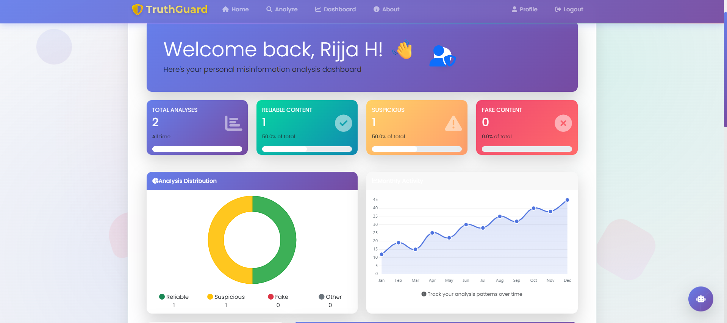
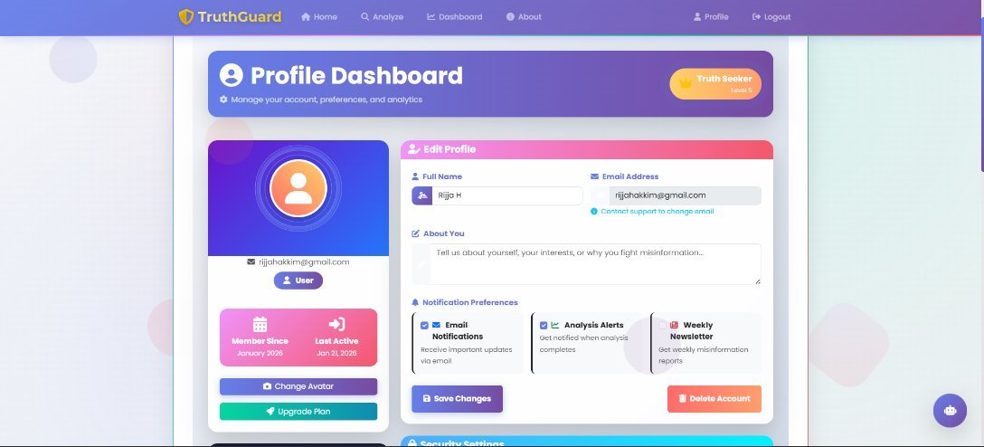
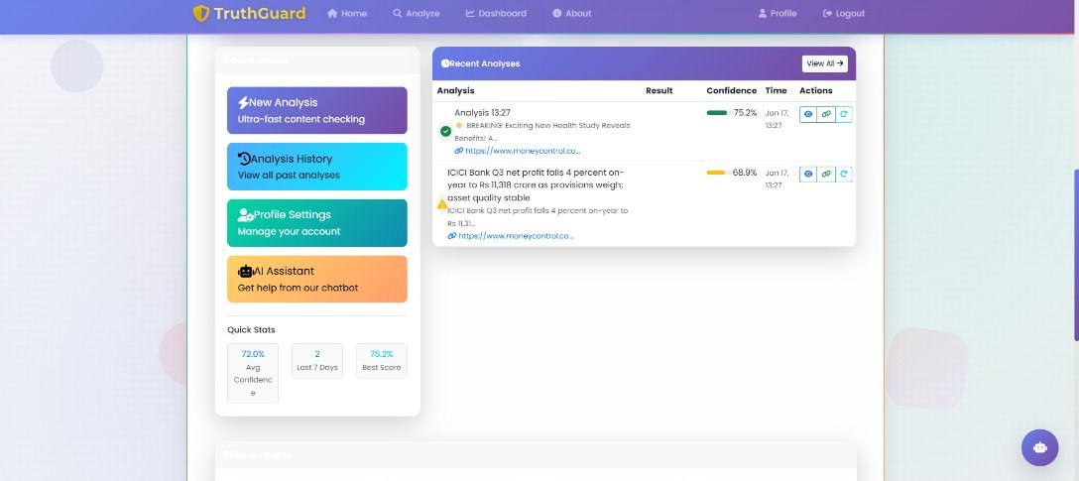
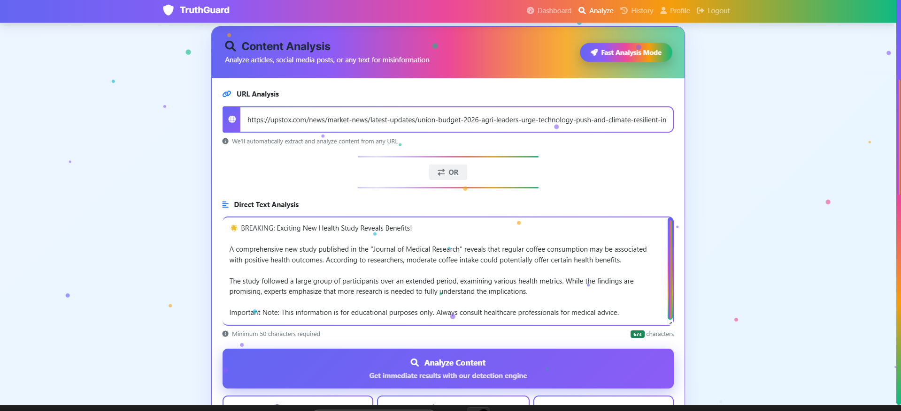
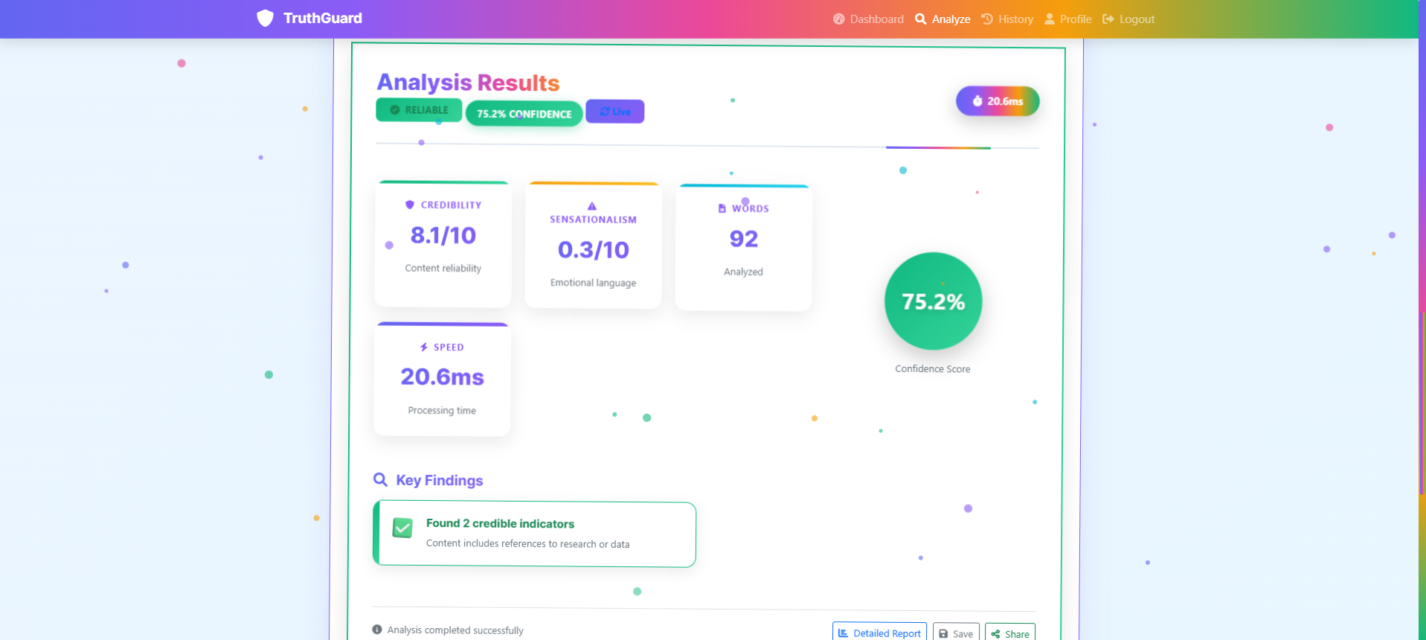
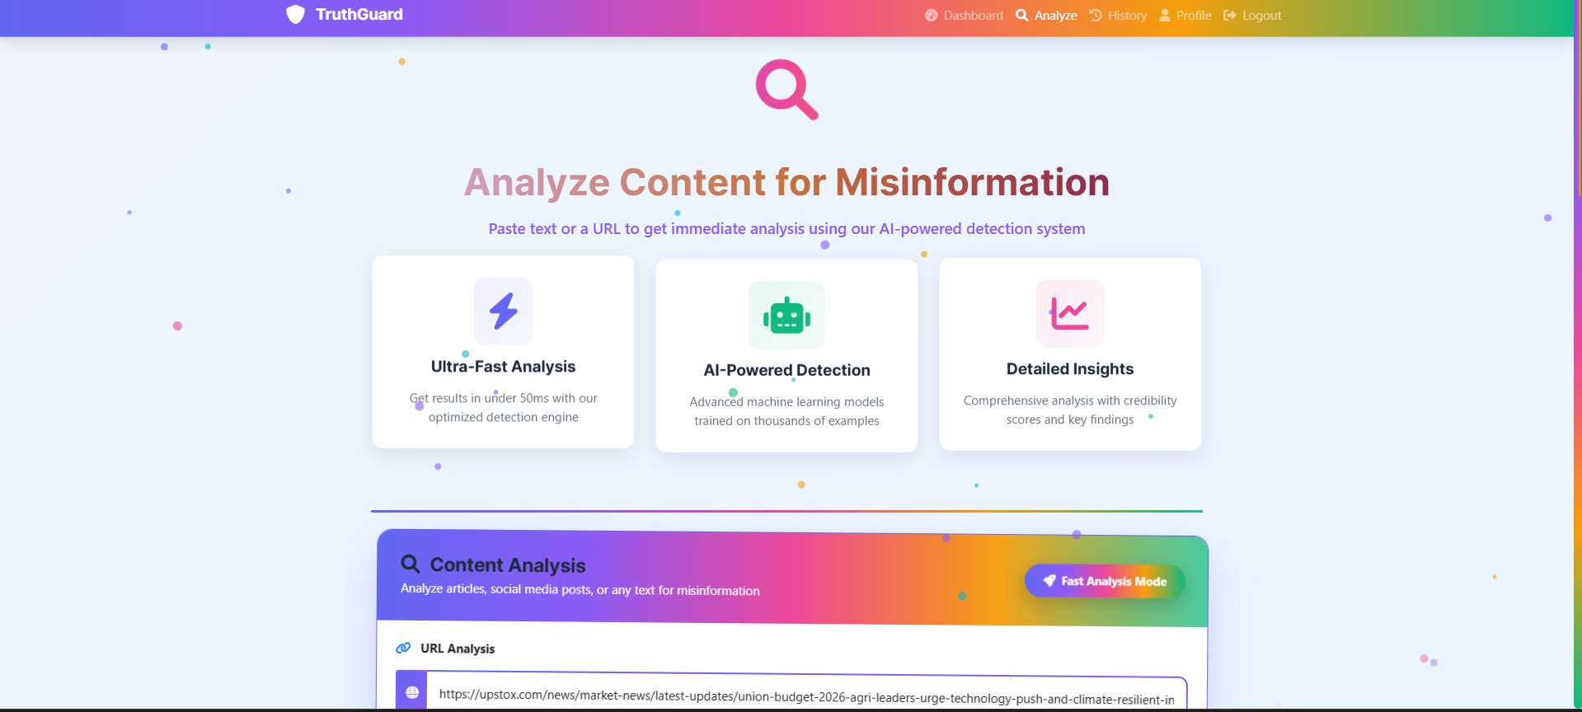
ScreenShots

